Slide 1
Restaurant Management System
Submitted by:
Khim bahadur chhetri
Arjun kharel
Dikshanta poudel

Slide 2
IntRODUCTION
Restaurant is place where we have to deal with a number of customers, and the key to success is customer satisfaction.
Restaurant Management System has been proposed to be implemented to replace the manual system
The main aim of this project is computerization of all processes which happen in Restaurant

Slide 3
Drawbacks of existing system
Traditionally, restaurant management involved a lot of manual processes and paperwork, which made it time-consuming, mistake, and inefficient.
Existing system is maintained manually , which often resulted in miscommunication , delays and customer dissatisfaction.
Manually taking orders from customers and sending them to the kitchen staff.
Reports are not easily generated whenever it is needed.
Less accuracy

Slide 4
Drawbacks of existing system
Traditionally, restaurant management involved a lot of manual processes and paperwork, which made it time-consuming, mistake, and inefficient.
Existing system is maintained manually , which often resulted in miscommunication, delays and customer dissatisfaction.
Manually taking orders from customers and sending them to the kitchen staff.
Reports are not easily generated whenever it is needed.
Less accuracy

Slide 5
Drawbacks of existing system
Traditionally, restaurant management involved a lot of manual processes and paperwork, which made it time-consuming, mistake, and inefficient.
Existing system is maintained manually , which often resulted in miscommunication, delays and customer dissatisfaction.
Manually taking orders from customers and sending them to the kitchen staff.
Reports are not easily generated whenever it is needed.
Less accuracy

Slide 6
Statement of problem (sop)
Some potential problems and challenges in restaurant management system are:
Inaccurate inventory management:
Overstocking or stock shortages, which can lead to wasted food, increased costs, and lost revenue.
Poor customer service :
Long wait times, inaccurate orders, and other service-related issues can lead to customer dissatisfaction and negative reviews, which can harm the restaurant's reputation and profitability.

Slide 7
objective
To maximize profit by increasing efficiency without compromising customer satisfaction.
To reduce the time and cost associated with restaurant management
To reduce paper-based system and improve communication.
To provide fast and efficient services to the customer.
To manage orders, track inventory and generate bills in real-time.

Slide 8
Operational feasibility
The proposed system is operationally feasible because of the following reasons.
Users can meet their expectations in a shorter time
The restaurant is located in an area that is easily accessible to customers and suppliers
Proper parking facility
The staff are properly trained and experienced in food service

Slide 9
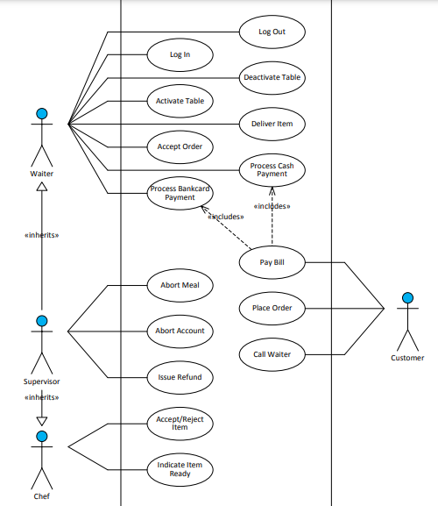
Use case design

Slide 10
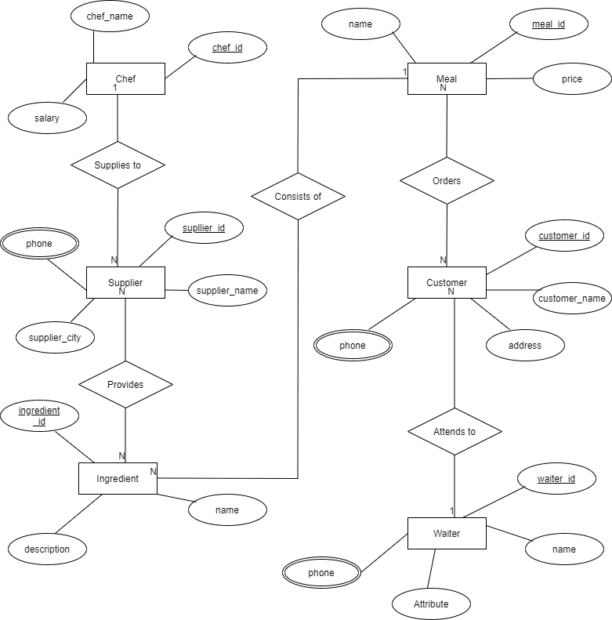
Entity relation diagram

Slide 11
Implementation
Software requirement
There are numerous of software used in the development of this system. Basic Software requirements necessary for the smooth functioning of this project are as follows:
Operating system: Any (Windows, Linux, MacOS)
Text Editor
Web Browser: Any

Slide 12
implementation
Tools and Technique
The framework and language to be used for the project :
Fronted
HTML, CSS, Java Script
Backend
Framework -Django
Database -SQLite

Slide 13
implementation
Hardware Requirement
Processor: A multi-core processor with a clock speed of at least 2.0 GHz or Higher is recommended
RAM: Minimum 4GB of RAM
Storage: A minimum of 10GB of free disk space is recommended

Slide 14
Future work
Allow customers to customize food orders and reservation system
Allow to save payment details for future use
Allow to find and choose a nearby restaurant

Slide 15
conclusion
The implementation of a Restaurant Management System has been proposed to be implemented to replace the manual system. This project was made user friendly by using basic visual enabling the user to interact easily .

Slide 16
references
DOI:
https://www.slideshare.net/joilrahat/restaurant-management-presentation?from_action=save
Carl Abernethy, https://www.academia.edu/36675814/Restaurant_Management_System, 5th May 2010

Slide 17
Thank you

